Slide 1

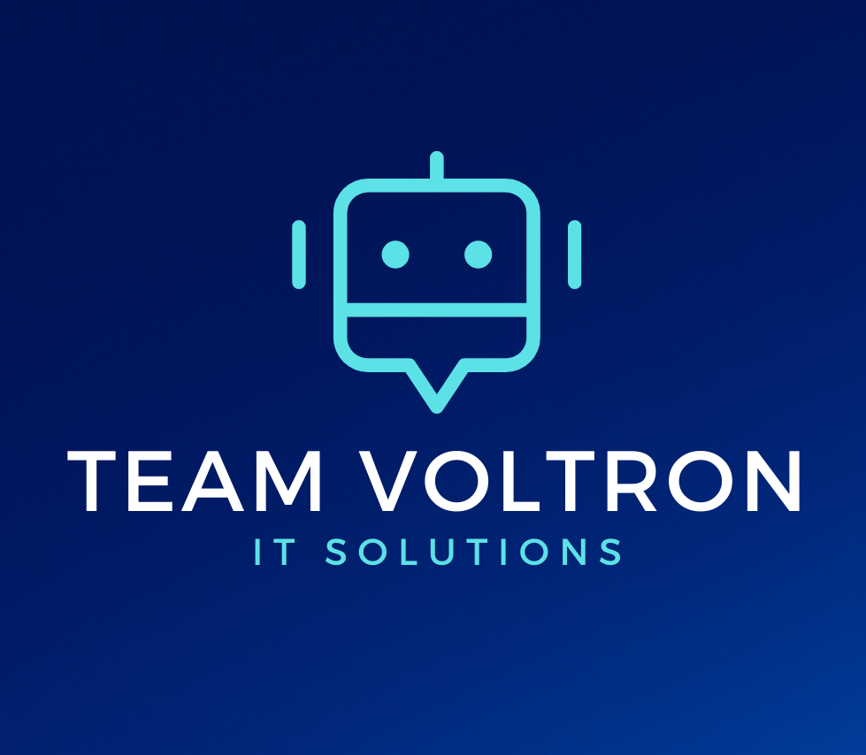
Ryan Hurley, Aaron Saylor, Brendon Carter, Ryan Foster, Michael Gibson, John Keller, Tyler Justice

Slide 2
Agenda
Problem Statement
Business Case
System Requirements
PMS & CMS
ERD & Window Navigation Diagram
Prototypes
Feasibility & NPV

Slide 3
Problem Statement
Financial
The organization needs a secure and accessible way to collect and track revenue streams.
Volunteers
The organization needs a secure and accessible way to track and organize participant information
Organization
The Thompson Project currently keeps all records on paper without any significant file/data keeping structure.
Outreach
The organization currently lacks the ability to have simple community interactions through social media. The organization also does not currently hold a stable contact for potential partnerships, volunteers, donors, etc.

Slide 4
Business Case
Goal - To create a website that enables the Thompson project to engage volunteers, inform community, and ultimately mentor more clients
Limitations - Lack of technical experience, proper equipment, and inability to scale rapidly
Approach - Develop website with various process functions, and enable easier tracking of business processes. Project to be delivered by April 1.
Benefits - Greater involvement from community and additional funding to mentor more children across the region. Easier management of data and personnel.

Slide 5
System Requirements
System will:
Possess detailed and complete backups
Possess recovery features from backups
Contain a database of mentors, mentees, and administrators
Have ability to edit website content
Be able to efficiently process payments
Have capability to edit database entities
Have capability of doing background checks
System will be able to conduct Title IX training
*only the most important requirements are listed

Slide 6

PMS and CMS: Wild Apricot
This provider is focused on Nonprofits, and integrates the database, CMS, and PMS into one wrapped package. This, coupled with fully available support staff makes it the perfect fit.
Affordable Content Management System
Starts with a free plan and scales as you grow
Includes use of Wild Apricot’s Payment Management System
Payments will be seamless with CMS
Includes tools and content specifically created for Non-Profits
Includes a database system that syncs with PMS system
Includes email system for user engagement

Slide 7
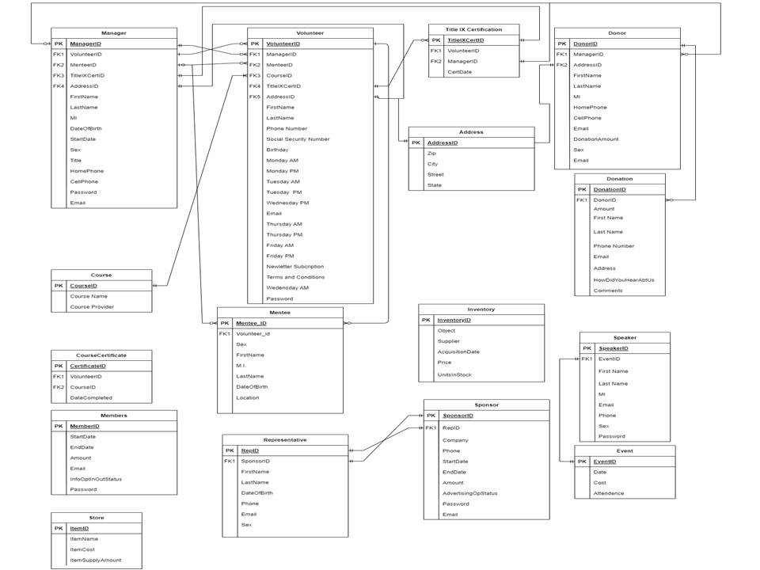
ERD Overview

Slide 8
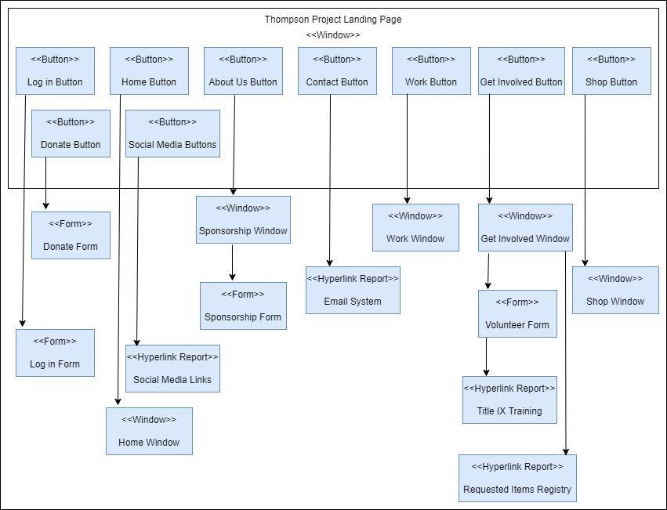
Window Navigation Diagram

Slide 9
Prototypes
Home Page
About Us Page
Volunteer Form Page
Donation Pages

Slide 10
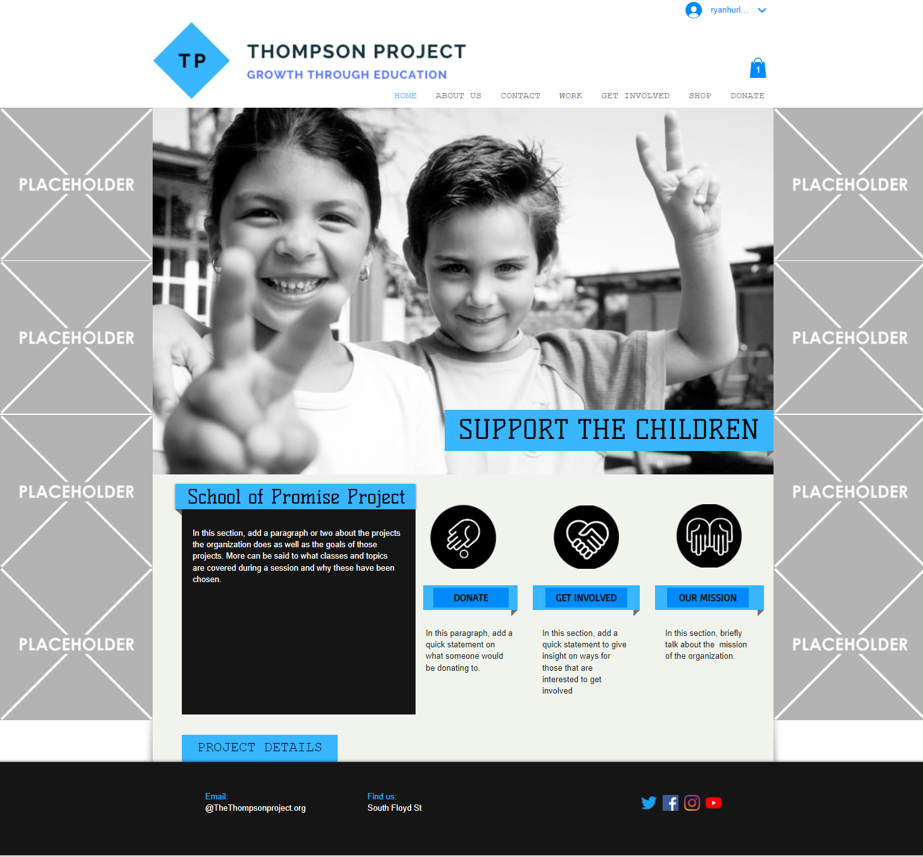

Slide 11
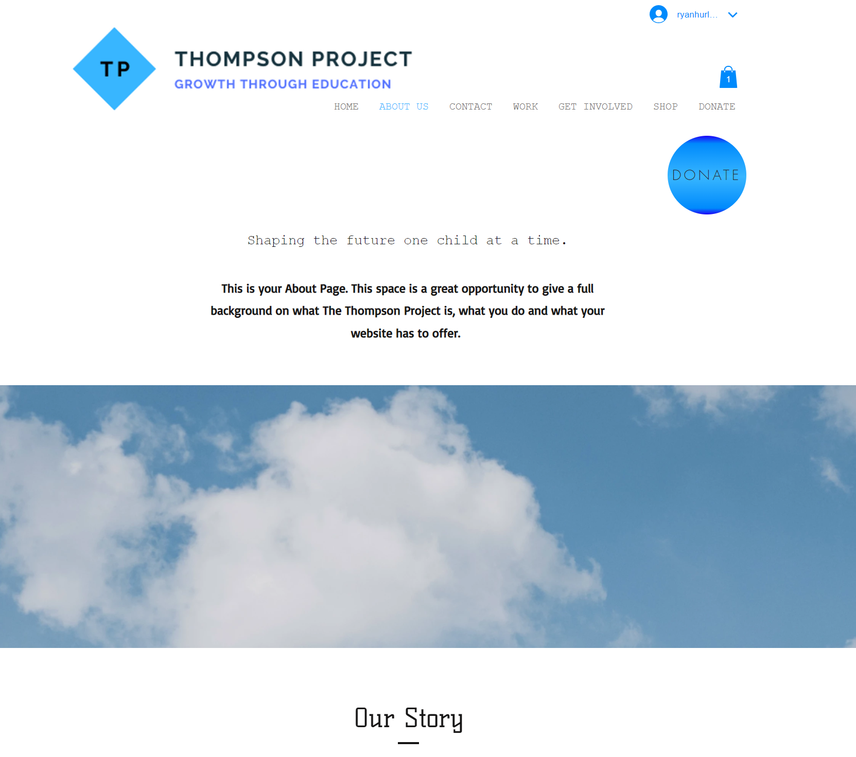
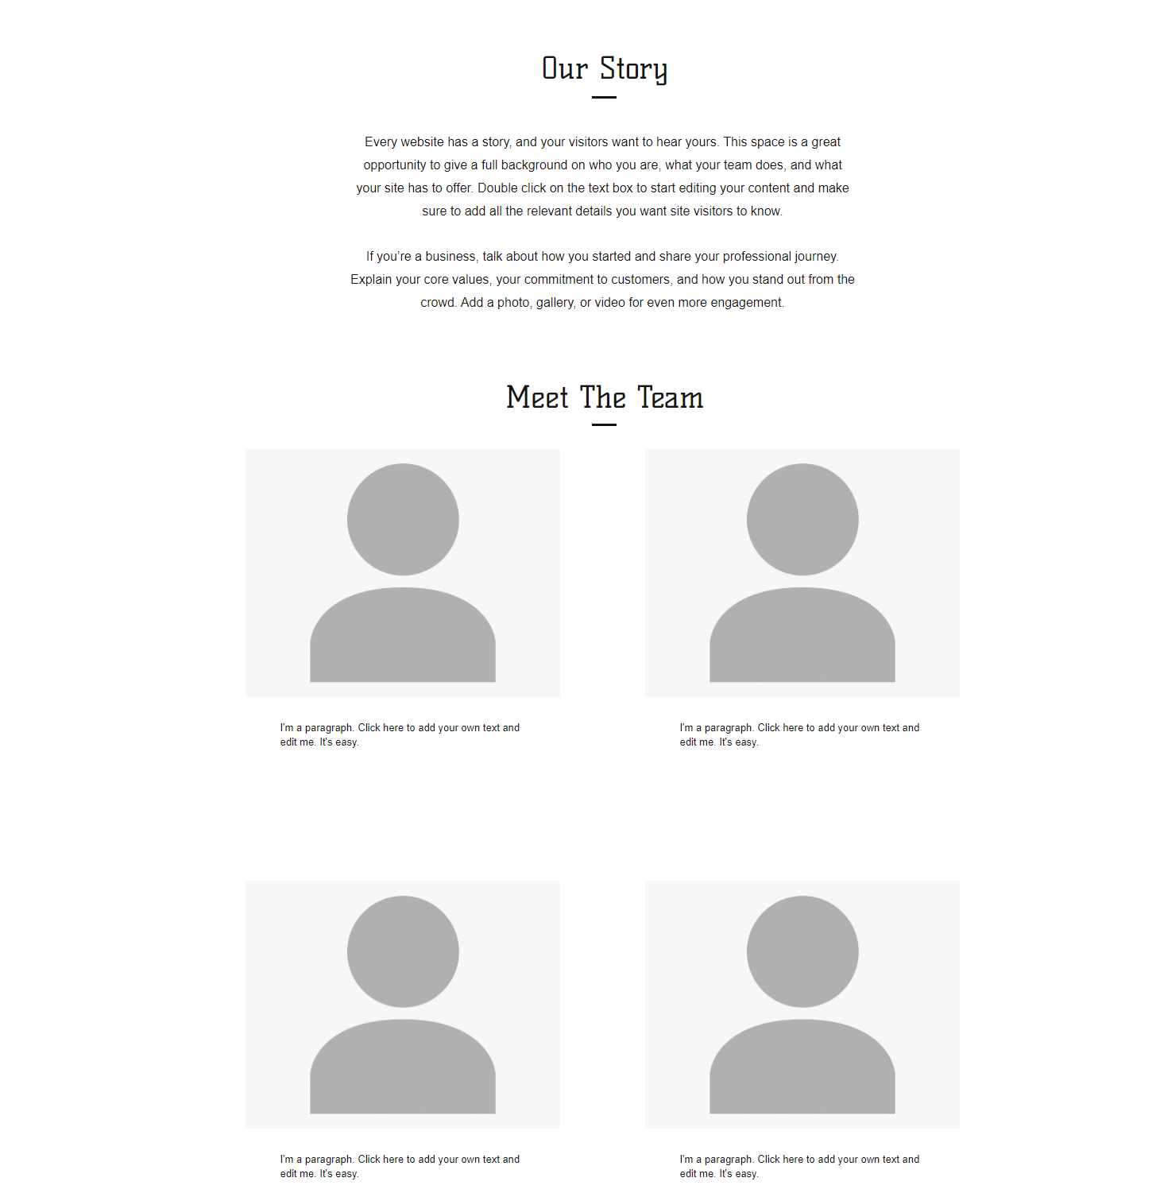

Slide 12
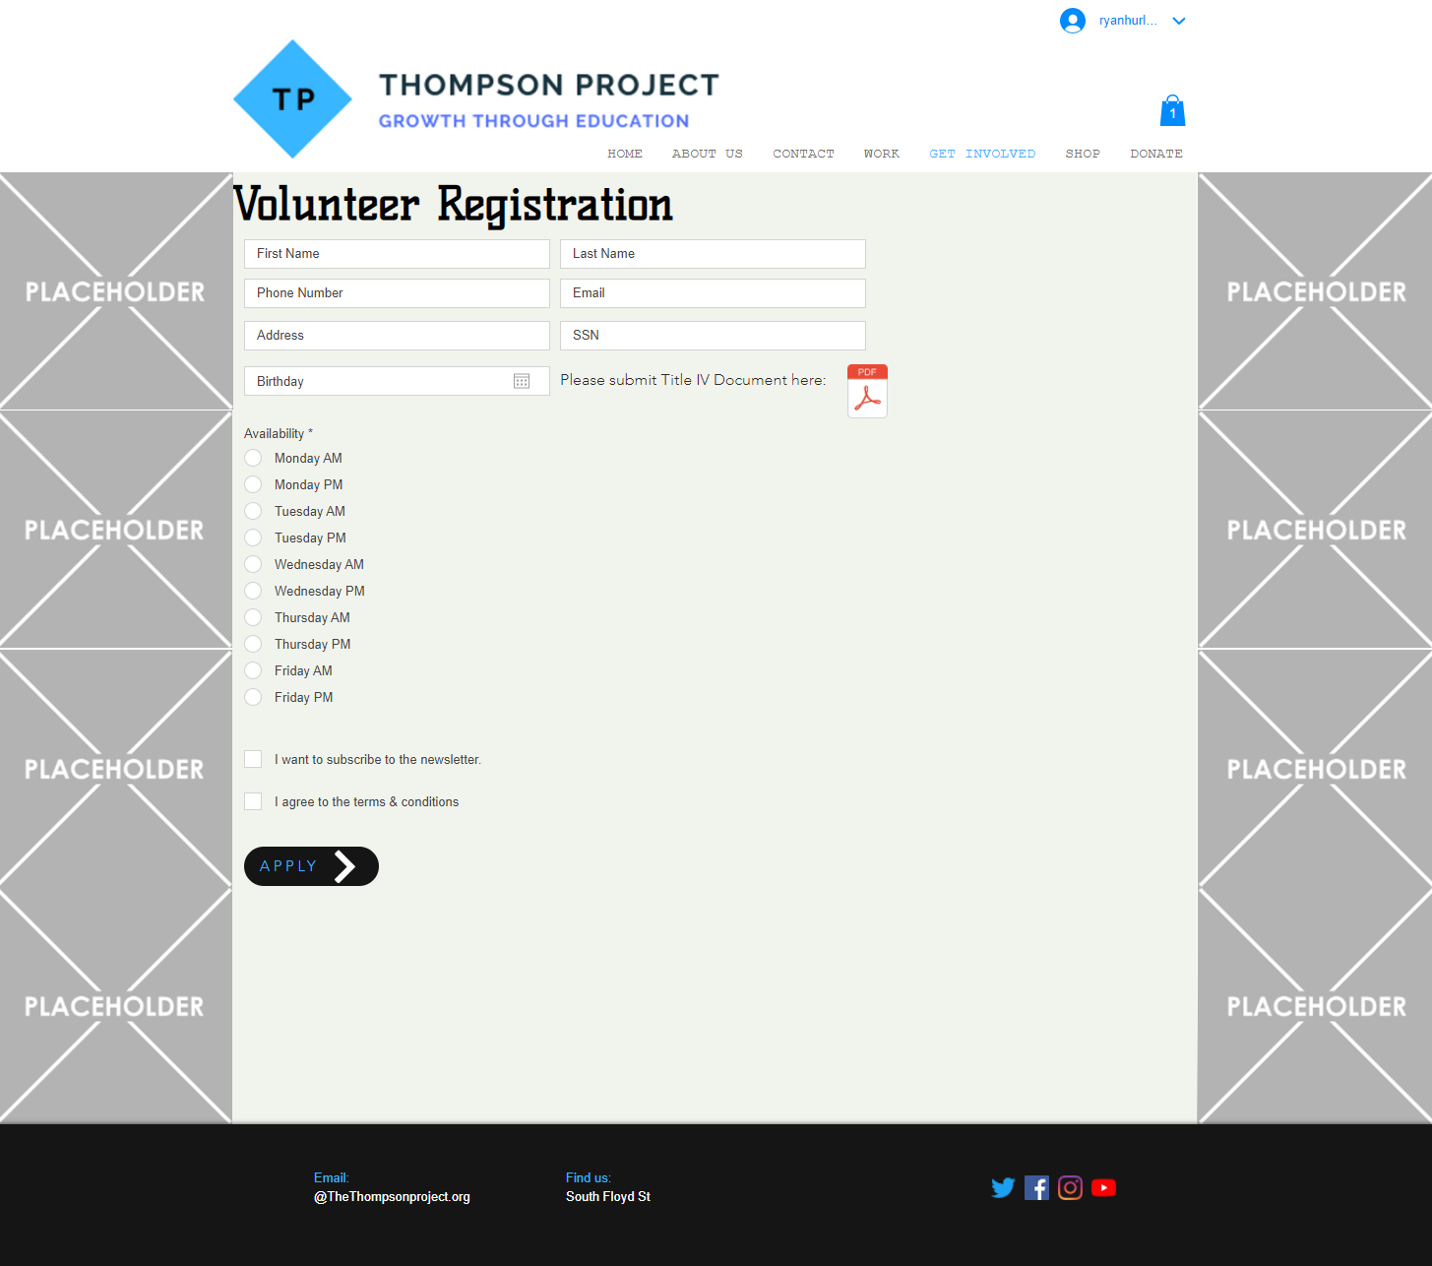

Slide 13
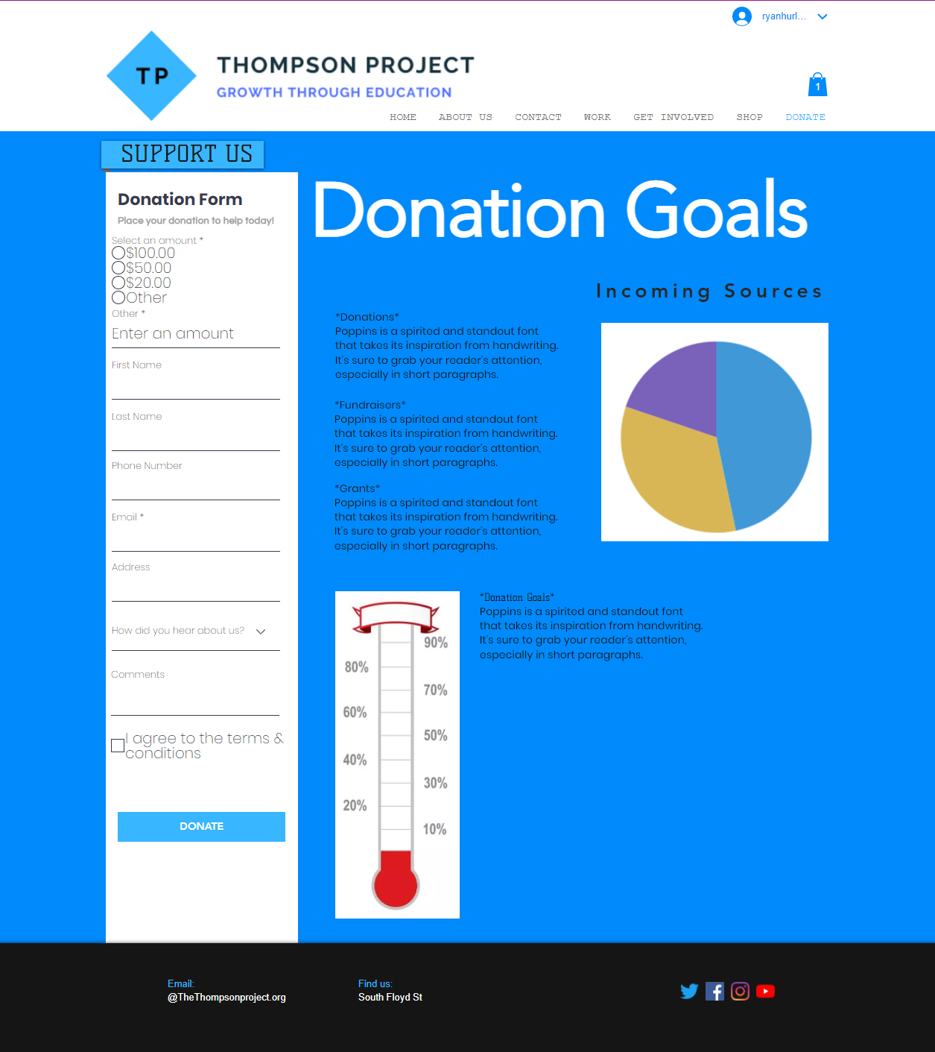
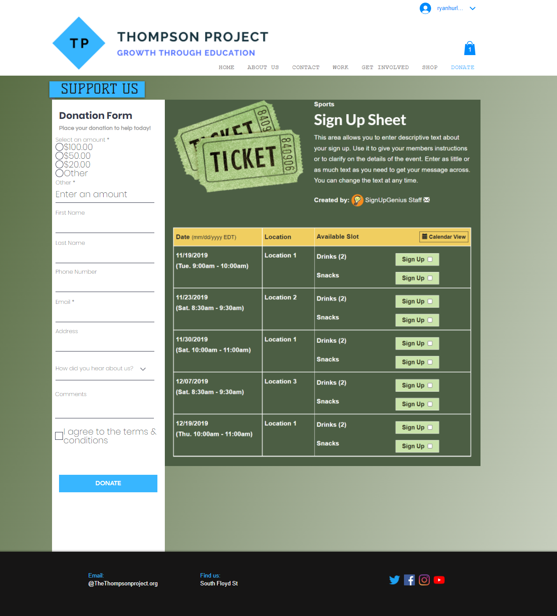

Slide 14
Feasibility Overview
Technical Feasibility
Operational Feasibility
Economic Feasibility

Slide 15

Technical and Operational Feasibility
TECHNICAL
Hardware
Software
OPERATIONAL
Training
Implementation

Slide 16
Economic Feasibility
1. Donations:
2. Fundraising:
3. Grants:
Average Donation: $19/month/individual
45% of Donors give monthly
50 total Individual Donors
23 Guaranteed Donors/month
23 Donors * $19.00 * 12 months = $5,244.00 annually
Expense Ratio <= 35%
3 Events for the year =
Target $2,500/ event
ER = 35%
$2,500(0.35) = $875
$2,500 - $875 = $1,625
$1,625 * 3 Events = $4,875
In 2019, 98% of grant seekers who submitted 6 grant applications or more received at least one award
16.67% success rate
Average award to organizations with assets < $1,000,000 is $6,000/grant

Slide 17

Economic Feasibility
$16,119.00
_____________

Slide 18
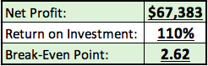
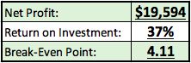
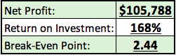
NPV

Slide 19
What did we cover?
Problem Statement
Business Case
System Requirements
PMS & CMS
Prototypes
$16,119.00

Slide 20
Thank you for your time!
Questions?

